Slide 1

Unit 2
Lecture 1

Slide 2
Topics:
What do you mean by Image Enhancement?
Necessity of image enhancement
Enhancement Operations
Spatial domain operations
Frequency domain operations

Slide 3
Image Enhancement
Processing of the image to enhance certain features of the image
The resultant image is more suitable for the application than the original image
Problem domain dependent
Image captured by camera can be dark, we have to increase the contrast
Edges of the objects must be highlighted, needs a different kind of enhancement
Techniques of enhancement of one type of images may not be suitable for the other types of images

Slide 4
Enhancement can be done in spatial or frequency domain
Spatial Domain:
Works directly on pixels of the image
Frequency Domain:
Enhancement in the transformed domain
Take Fourier transform of the image
Modify the Fourier transform coefficients of the image
Take inverse Fourier transform of the modified image to get the enhanced image

Slide 5
Spatial Domain
Works directly on the pixels
There must be some transformation function of the image pixels from the original image to the pixels in the processed image
Such a transformation function is defined as
g(x)= T[f(x)]
Where
g(x) is the enhanced image
T is the transformation function
f(x,y) is the original image in 2D representation

Slide 6
Operator T works over a neighborhood of the image
Neighborhood can be 3x3, 5x5 and 8x8 etc.

Slide 7
Example:
Neighborhood is 3x3 square.
Operation is to compute the average intensity of the neighbors
Origin of neighborhood is f(x,y)
Origin now moved to the next location
 | 20 | 30 | 15
 | 7 | 10 | 10
 | 10 | 8 | 9
(20+30+15+7+10+10+10+8+9)/9
119/9= 13
f(x,y)=13

Slide 8
If the origin is in the border, either ignore the neighbors or zero pad
the image
0 | 0 | 0 | 0 | 0 | 0 | 0
0 | 0 | 0 | 0 | 0 | 0 | 0
0 | 0 | 20 | 10 | 30 | 0 | 0
0 | 0 | 10 | 5 | 40 | 0 | 0
0 | 0 | 7 | 5 | 10 | 0 | 0
0 | 0 | 0 | 0 | 0 | 0 | 0
0 | 0 | 0 | 0 | 0 | 0 | 0
20 | 10 | 30
10 | 5 | 40
7 | 5 | 10

Slide 9
The process discussed is called spatial filtering.
Neighborhood along with a predefined operation is called the
spatial filter or spatial mask or spatial kernel, template, window etc.
Smallest possible neighborhood is 1x1
g depends only on one pixel
s= T(r)
T is a transformation that maps the pixel value r to a pixel value s.
Point operations: operations are based on intensity at a point only than the neighbourhood (intensity transformations)

Slide 10
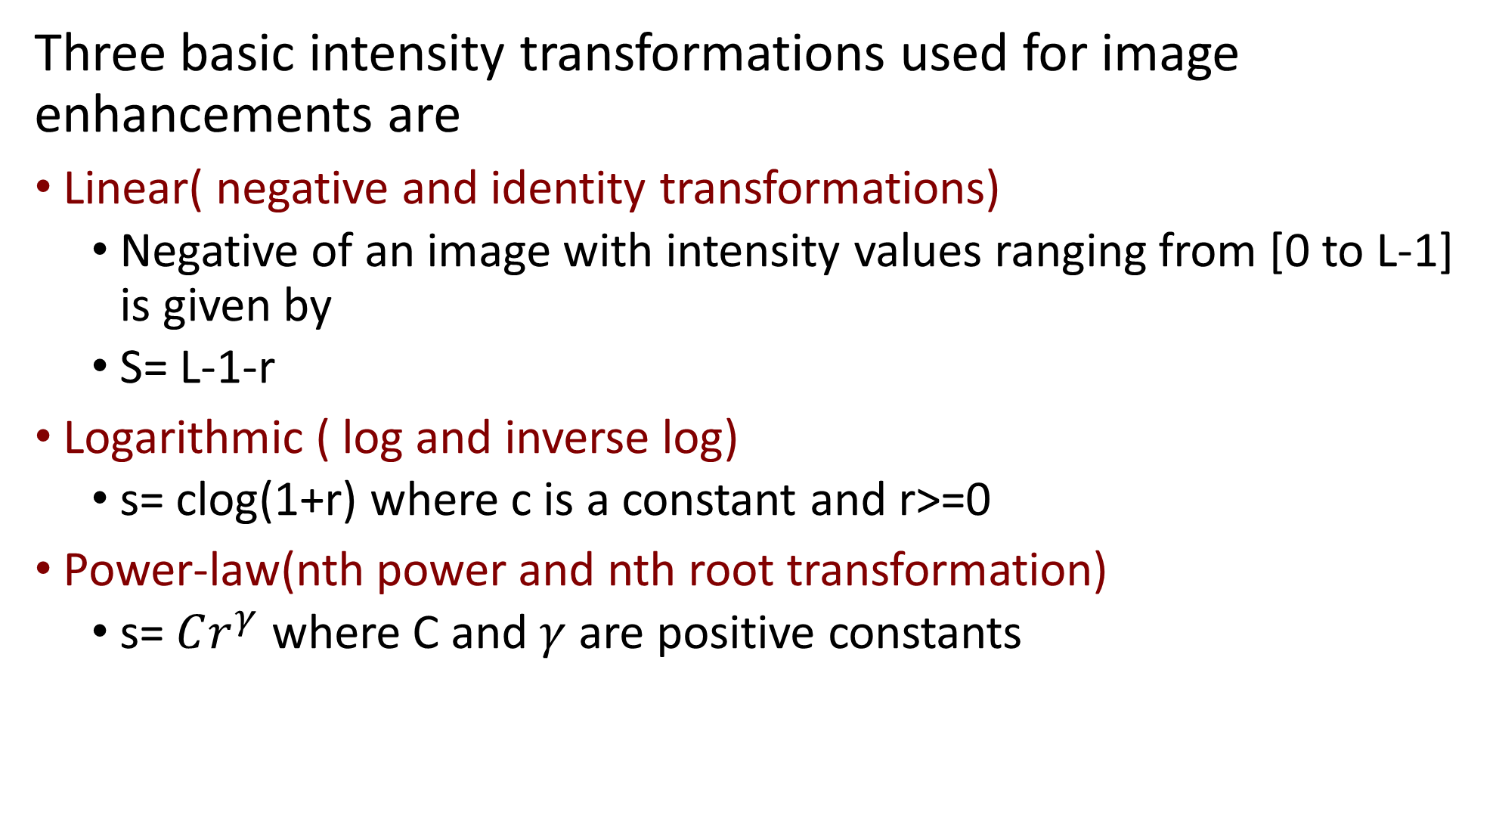
Three basic intensity transformations used for image enhancements are
Linear( negative and identity transformations)
Negative of an image with intensity values ranging from [0 to L-1] is given by
S= L-1-r
Logarithmic ( log and inverse log)
s= clog(1+r) where c is a constant and r>=0
Power-law(nth power and nth root transformation)
s= $Cr^{γ}$ where C and $γ$ are positive constants

Slide 11
Negative image
S=(L-1)-r
How to calculate the maximum intensity value L?
8 bit image, so maximum pixel value is 256
2^8=256
Subtract each pixel value from the maximum value L-1
2^3=8
n=3
L=2^3=8
L-1= 7
s = 7-4=3
Used for enhancing white or gray detail embedded in the dark regions of an image
4 | 3 | 5 | 2 | 6
3 | 6 | 4 | 6 | 4
2 | 2 | 6 | 5 | 5
7 | 6 | 4 | 1 | 1
7 | 4 | 4 | 3 | 2
3 | 4 | 2 | 5 | 1
4 | 1 | 3 | 1 | 3
5 | 5 | 1 | 2 | 2
0 | 1 | 3 | 6 | 6
0 | 3 | 3 | 4 | 5

Slide 12
Negative of an image

Slide 14
Logarithmic Transformations( log and inverse log)
s= clog(1+r) where c is a constant and r>=0
C=1
4 | 3 | 5 | 2 | 6
3 | 6 | 4 | 6 | 4
2 | 2 | 6 | 5 | 5
7 | 6 | 4 | 1 | 1
7 | 4 | 4 | 3 | 2
Log(5) | Log(4) | Log(6) | Log(3) | Log(7)
Log(4) | Log(7) | Log(5) | Log(7) | Log5
Log3 | Log3 | Log7 | Log6 | Log6
Log8 | Log7 | Log5 | Log2 | Log2
Log8 | Log5 | Log5 | Log4 | Log3

Slide 15
Used to expand the values of dark pixels in an image while compressing the higher values
As the value of C increases image becomes more brighter

Slide 16

Power-law(nth power and nth root transformation)(Gamma correction)
s= $Cr^{γ}$ where C=1 and $γ=0.2$ are positive constants
4 | 3 | 5 | 2 | 6
3 | 6 | 4 | 6 | 4
2 | 2 | 6 | 5 | 5
7 | 6 | 4 | 1 | 1
7 | 4 | 4 | 3 | 2
4^0.2

Slide 18
Gamma Correction
Gamma value > 1 output image will be darker.
Gamma value < 1 output image will be lighter.

